Slide 1
Arrays
Array Introduction | Adding and Removing Array Elements | Looping Through an Array | Passing Array to Functions | Searching an Array | Sorting an Array
Notes:
Welcome to our lecture on arrays. In this lecture we will go through Array Introduction, Adding and Removing elements from array, Looping Through an Array, how to pass array to functions, how to search an element in an Array, and how to sort an Array. Let’s start our lecture.

Slide 2
Introduction to Arrays
Definition: An array is an ordered collection of values, called elements, stored at numeric locations called indexes.
Initialization: Arrays are initialized using brackets [] with comma-separated values (e.g., let arr = [1, 2, 3];).
Dynamic Size: Arrays can grow as elements are added and shrink as elements are removed, and they can hold values of the same or different types.
Notes:
Arrays are an essential part of JavaScript, used to store an ordered collection of values called elements. Each element is stored at a numeric location known as an index. To create an array, use square brackets and separate values with commas. Arrays are flexible; they can grow as you add elements and shrink as you remove them. They also allow storage of values of the same or different types.

Slide 3
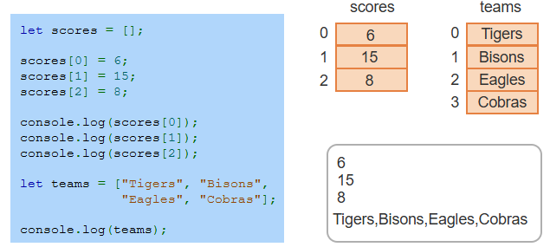
Example
Notes:
In this example, we create an empty array named scores and add values to it using numeric indexes. The values are then accessed and logged to the console individually. Next, we define an array called teams with a list of strings. This array holds team names, which are also logged to the console. Arrays allow storing and accessing data efficiently, whether numbers or strings, using indexes.

Slide 4
Adding and Removing Array Elements
Array as an Object: Arrays are Array objects that provide various methods to manipulate their elements.
Methods: A method is a function tied to an object, operating on the object's data.
Calling Methods: Methods are called using the object name followed by the method (e.g., myArray.method();).
Notes:
Arrays in JavaScript are objects that come with built-in methods to add or remove elements. A method is a function attached to an object, allowing us to manipulate the data stored in it. To use a method, call it by attaching it to the array object with a dot. For example, my Array dot method lets you apply specific operations, making arrays highly versatile for data manipulation.

Slide 5
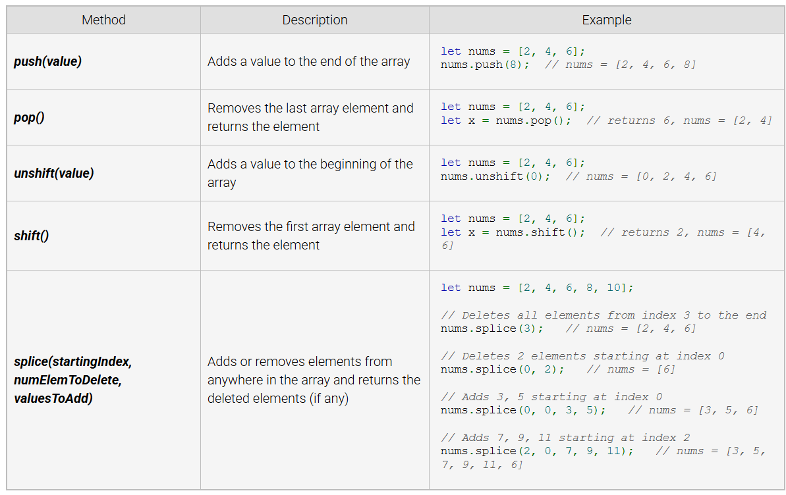
Array methods for adding and removing array elements
Notes:
This table shows common methods for adding and removing array elements in JavaScript. The push method adds elements to the end, while pop removes the last element. Unshift adds elements to the beginning, and shift removes the first element. Splice is more versatile, allowing elements to be added or removed from any position, making these methods essential for flexible array management.

Slide 6
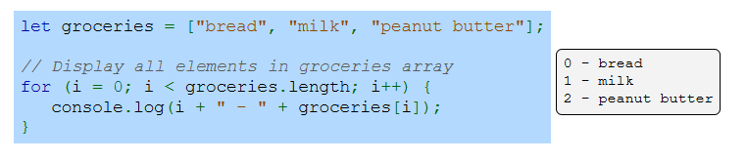
Looping Through for Loop
Notes:
This slide demonstrates using a for loop to iterate through an array in JavaScript. The groceries array contains items like bread and milk. The for loop starts at index 0 and continues until it reaches the end of the array using groceries dot length. Each item is displayed with its index using console.log. For loops are a fundamental way to process and display array elements efficiently.

Slide 7
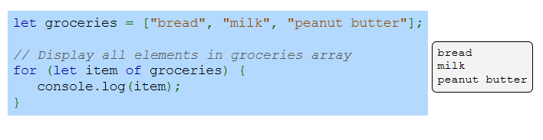
Looping Through for-of Loop
Notes:
This example demonstrates the use of the for-of loop to iterate through an array in JavaScript. The groceries array contains items like bread and milk. The for-of loop simplifies iteration by directly accessing each element in the array using a variable such as item. Each element is displayed using console.log, making the for-of loop a clean and efficient way to process arrays.

Slide 8
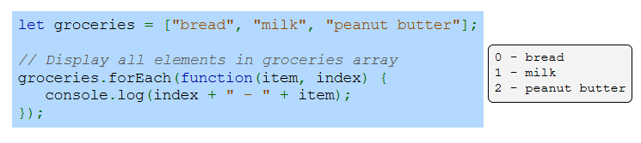
Looping Through for-each Loop
Notes:
This is another example for how to use the for Each method to iterate through an array in JavaScript. The groceries array contains items like bread and milk. The for Each method takes a function as an argument, which processes each element and its index. The index and item are logged to the console, providing both the position and value. This method is useful for applying actions to every array element.

Slide 9
Passing Arrays to Function
Array as Argument: Arrays can be passed to functions as arguments.
Modification: Functions can modify the elements of the array passed to them.
Reference: Arrays are passed by reference, meaning changes in the function affect the original array.
Notes:
Now we will discuss how arrays are passed to functions in JavaScript. Arrays can be passed as arguments to functions, and the function can modify the elements of the array. Since arrays are passed by reference, any changes made to the array inside the function will affect the original array outside the function. This allows for dynamic manipulation of array data.

Slide 10
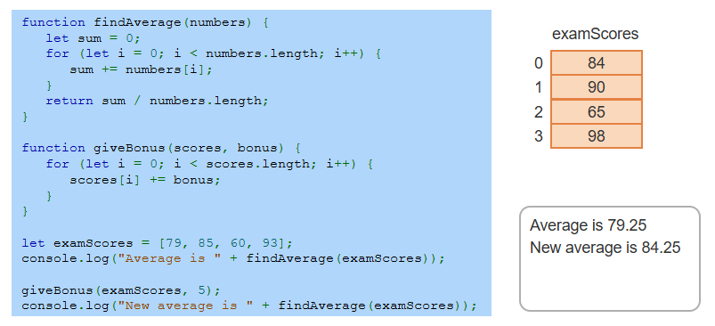
Example
Notes:
This example shows two functions find Average and give Bonus. The find Average function calculates the average of numbers in an array by summing the elements and dividing by the length. The give Bonus function adds a bonus to each score in the array. The exam Scores array is processed using these functions, first calculating the average and then applying a bonus, followed by recalculating the new average.

Slide 11
Sorting an array
Sorting Method: The sort() method sorts an array in ascending order by default.
Default Behavior: Elements are sorted as strings based on their Unicode values, which may produce unexpected results for numbers (e.g., "10" < "2").
Example Issue: When sorting numbers, 10 is placed before 2 due to string comparison of "1" and "2".
Notes:
By default, sort arranges array elements in ascending order but treats them as strings, comparing their Unicode values. This can cause unexpected results when sorting numbers, such as placing 10 before 2. To handle such cases, a custom comparison function can be passed to the sort method for proper numerical or specific order sorting.

Slide 12
Sorting an array
The sort() method can use a custom comparison function to define the sorting order of elements:
Returns a value < 0 if the first argument should appear before the second argument.
Returns a value > 0 if the first argument should appear after the second argument.
Returns 0 if the order of the first and second arguments does not matter.
Notes:
Here are some method that return value to determine the sorting order. The sort method can use a custom comparison function to control the sorting order of array elements. The comparison function returns a value less than zero to place the first argument before the second, a value greater than zero to place it after, and zero if their order is irrelevant. This provides flexibility to sort arrays numerically, alphabetically, or based on specific conditions.

Slide 13
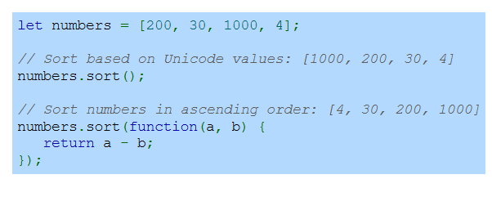
Example
Notes:
In this example, the numbers array is first sorted using the default sort method, which compares elements as strings based on their Unicode values, resulting in an incorrect order. To sort numerically in ascending order, a custom comparison function is passed to sort. The function subtracts one value from the other, ensuring correct numerical sorting of the array elements.

